Slide 1
Yippster Integration In-App Purchasing
Integrating with Yippster is super easy!!
Server and client side configurations.

Slide 2
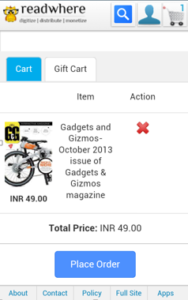
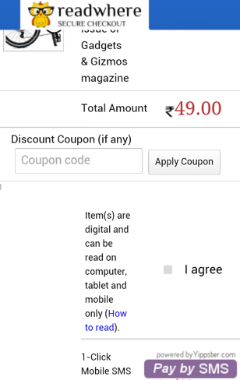
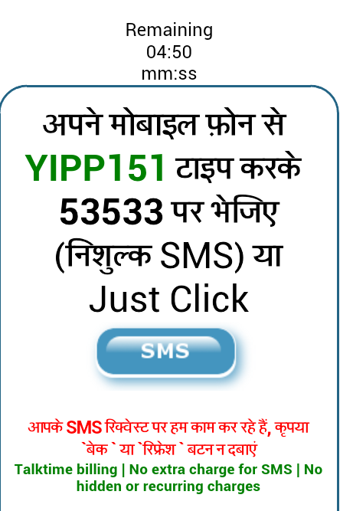
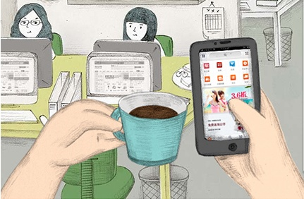
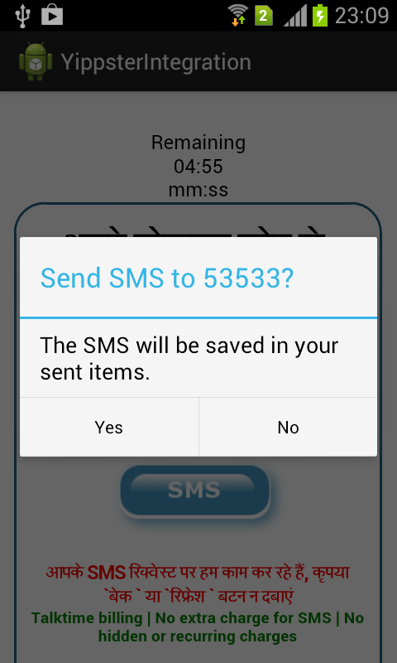
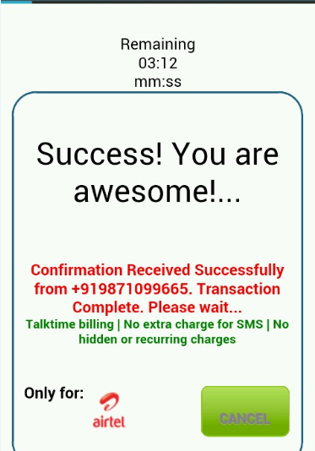

Yippster Solution on mobile app (in-app)
User sees an exciting Merchandise/ Paid Content on his phone on Wifi
Selects Content
Selects Easy Option of
‘Pay by SMS’
Clicks on the SMS button
And makes a quick payment
…life was never this easy!
Sends out the automatically formed SMS

Slide 3
Configurations
Server Side Configuration
(Slide # 4 -14. Skip if you have done Web Integration)
Client Side Configuration
(Slide # 15-19)

Slide 4
Server Side

Slide 5
The ‘demo’ application is the model for integration.
There are 6 PHP files in the demo:
1. index.php
2. ext.php
3. cancel.php
4. fail.php
5. receive.php
6. error.php
Parameter validation:
Secure hash creation should be exactly how it is in each corresponding file in the demo.
Steps and corresponding files:
A. Transaction initiation or the checkout page: 'index.php'
B. Gateway connection file: 'ext.php'
C. Transaction Confirmation files: 'cancel.php', 'fail.php', 'receive.php'
D. Error handling file: 'error.php'

Slide 6
Steps
A 10 parameters are initiated at the checkout page ‘index.php’ , of which 7 must have values and they are marked as necessary. The rest can have blank values.
1. Transaction ID (must be unique for every transaction) - necessary
2. Success URL (in this case, it is the URL of the receive.php file) - necessary
3. Fail URL (in this case, it is the URL of the fail.php file) - necessary
4. Cancel URL (in this case, it is the URL of the cancel.php file) - necessary
5. First Name
6. Last Name
7. Email-
8. Phone on record (can be different from the phone used for transaction).
9. Product Info- must not contain space character - necessary
10. Amount- integer only with no decimal point- necessary

Slide 7
B Gateway Communication:
4 additional parameters are initiated from the gateway connection page ‘ext.php’:
1. key- randomly generated, session specific salt – necessary (can be the same as transaction id)
2. Merchant ID - necessary
3. The secret hash, made with various parameters, including the randomly generated salt and the merchant secret key - necessary
4. lang – language support which currently only supports Hindi (lang=hi). The default is English.
NOTE:
Replace the demo MerchantID and key with those provided in the ‘ID AND KEY’ document.
The hash computation scheme and the form parameter names should be exactly as mentioned in the 'ext.php' file.

Slide 8
All 14 (10+4) parameters are submitted via POST request from the ‘ext.php’ page to the specified URL of Yippster domain
key=1eee58f&hash=a24b01d98ad54703b1f7bd048f0524ea&txnid=52250&surl=http%3A%2F%2Flocalhost%2Fdemo%2Freceive.php&furl=http%3A%2F%2Flocalhost%2Fdemo%2Ffail.php&curl=http%3A%2F%2Flocalhost%2Fdemo%2Fcancel.php&firstname=Anant&lastname=Kochhar&email=kochhar.anant%40gmail.com&phone=9868759665&productinfo=IndiaToday+RW2&amount=1.5&lang=hi&merchantID=0000

Slide 9
C
There are 3 transaction states: cancel, fail, success.
1. Cancel can be user initiated or system initiated. Confirmation is received at 'cancel.php'. The GET parameter 'cause' identifies the reason, while the ‘hash’ parameter confirms the authenticity of the call.
http://localhost/demo/cancel.php?hash=6a7baf09e7a01b681d88518662e00f66&cause=cancel&txnid=30607
System Initiated Cancellation occurs when:
User is attempting to buy the same product with the same mobile number within 15 minutes.
User does not have sufficient balance to purchase the product.
System is experiencing problems.

Slide 10
2. Fail occurs in circumstance when a transaction record is not even created on our systems. The confirmation is received by 'fail.php'. The URL parameter ‘cause’ identifies the reason, while the ‘hash’ parameter confirms the authenticity of the call.
http://localhost/demo/fail.php?txnid=39868&cause=anothertxn&salt=921&hash=a20f45f00ddd1dd06900b10f98cfefe8
Fail occurs when:
User tries to execute 2 payments simultaneously.
A previously used transaction ID is being used by the merchant.
3. Success occurs when all systems work smoothly. Confirmation is received at 'receive.php' as a POST request:
key=daa96d9&hash=d98a6b9361570fb3e47d32df919f312d17109186b351f1e74709c4efe48f17773d732e6af8ac3bb3564c561a237059d802ba008e38d01c061bedd46666675979&payphone=%2B919871099665&status=paid&txnid=40418
Note: The status and cause codes are explained in the ‘Yippster-Return-Codes-Descriptions-ver.1.0’ document.

Slide 11
D. Error page:
1. On failure of the hash computation, the user should be directed to an error page.

Slide 12
CODES ON RETURN URLs and THEIR DESCRIPTIONS
1. The following are the values in the 'status' parameter on the surl page (success):
'paid' : User successfully paid using his phone.
'already': User was prevented from paying for the content as he has time left on the same content from a previous purchase using his phone

Slide 13
2. The following are the values in the 'cause' parameter on curl page (cancel):
'cancel' : User cancelled the transaction by clicking on the cancel button.
'timeout' : The transaction timed out in the browser. User did not take any action.
'notok' : User does not have sufficient balance.
'already' : User cannot purchase the item since he has already purchased it in the last 15 minutes.
'unknown' : Unknown reason for cancellation from teleco.
'timedout' : Transaction timed out on the server end.
'badinternet' : Code was not shown and transaction was cancelled automatically as system detected bad internet on user end.

Slide 14
3.
The following are the values in the 'cause' parameter on the furl page (fail):
'anothertxn' : User has another transaction underway in the same browser and this transaction cannot proceed.
'repeat' : Same transaction ID has come from the merchant site again.
'down' : Systems are down.
Note: The difference between a ‘cancel’ and a ‘fail’ is that there are no logs maintained for a ‘fail’ in our systems.

Slide 15
Client Side

Slide 16
Configurations:
Add ‘CheckoutActivity.java, WebViewActivity.java, SuccessActivity.java, FailActivity.java, CancelActivity.java, ErrorActivity.java, TelephonyInfo.java in ‘src’ folder of your application.
Add the resource files : webview.xml, success.xml, checkout.xml, error.xml, fail.xml, cancel.xml in the layout folder and string.xml in the values folder.
Add necessary application components and permissions given in the manifest.xml in manifest.xml of your application.

Slide 17
Add title in receive.php, cancel.php, fail.php . Also set the static final field 'TRANSACTION_SUCCESSFUL_TOKEN' ,’ TRANSACTION_CANCELLED_TOKEN’, ‘TRANSACTION_FAILED_TOKEN’ in 'WebViewActivity.java' same as set in php files which acts as token to validate transaction confirmation.
Declare checkout page url (index.php)in the static final field ‘CHECKOUTURL' in 'WebViewActivity.java'.
Declare surl, curl, furl and error url in the static final field ‘SURL‘, ‘’CURL, ‘FURL’, ‘ERRORURL’ respectively in 'WebViewActivity.java'.
Change the minSdkVersion and targetSdkVersion accordingly.
Rename files , packages and imports, remove logs as desired .

Slide 18
Features:
1. The first activity(CheckoutActivity) has the button 'Pay by SMS', which takes to yippster's checkout page(if connnected to internet).
2. Permissions included in manifest.xml : WRITE_SMS, INTERNET, READ_SMS, SEND_SMS, ACCESS_NETWORK_STATE, ACCESS_WIFI_STATE, READ_PHONE_STATE.
3. Goes to SuccessActivity on successful transaction, FailActivity on failed transaction and CancelActivity on cancelled transaction.
4. SMS is saved in the sent items when the SMS is successfully sent.
5. Toast notifications is shown when the events such as SMS sent, SMS delivered, Generic failure, No service, SMS not delivered, Radio off are received.

Slide 19
6.1 Phone's in built SMSApp is launched to send SMS if:
User's device holds two sim cards and both the sims are ready.
6.2 AlertDialog to send SMS automatic​ally is launched if :
User's device holds single sim or
User's device holds dual sim but only one sim is used.
(Note: This feature is disabled for now because of regulatory issues)
7. When the transaction is cancelled, CancelActivity is shown and when the transaction is failed, FailActivity is shown.
8 . You can show the purchase in ‘SuccessActivity’. Currently it only has a textview.
9. Shows a Toast notification when not connected to internet.
10. Back button is disabled when the user presses back at the payment screen.

Slide 20
You are good to go!!

